Slide 1
Mycorrhizae Abundance and Diversity along a Hybridization Gradient in Pinyon Pine Trees
Jason Browne
NASA Space Grant Intern
Northern Arizona University

Slide 2
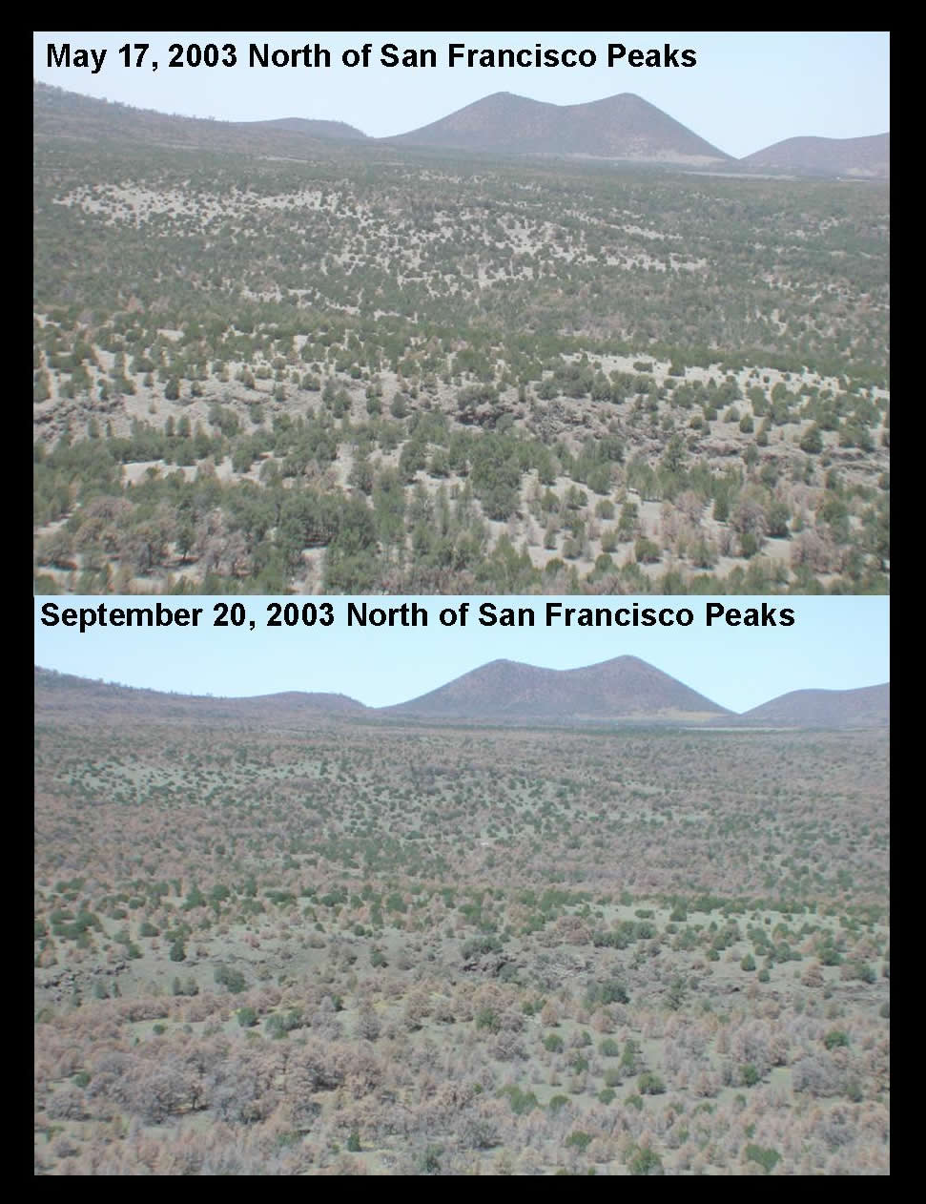
Introduction
Pinyon pine forest types are beginning to drastically diminish.
Many believe this is related to climate change and the resulting drought conditions
Two subspecies of pinyon exist in northern Arizona: two-needle (Pinus edulis var. edulis), and one-needle (Pinus edulis var. fallax)
*Courtesy of NAU Biology
Notes:
Going to talk about general die off that is occurring and some hypotheses about why it’s occurring. Also going to mention that a lot of study at NAU identifies Two needle pines as a key research subject area and point out that there are more than one type of pinyon-------this is a lot for one slide you might consider making it multiple slides and adding illustrations (dead pinyon for one and two, needle pictures for 3,

Slide 3
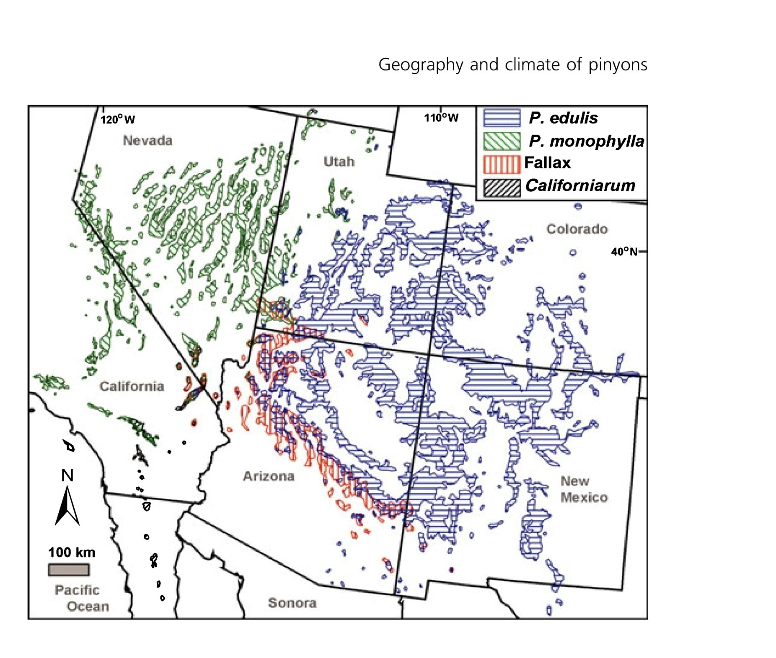
Cole et al. 2007

Slide 4
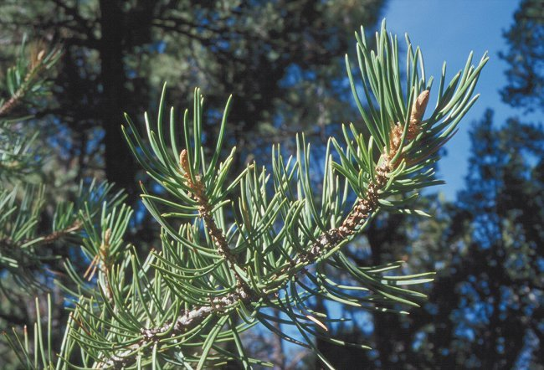
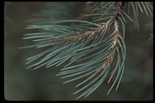
Introduction cont’d
2-needle and 1-needle pinyon pines co-exist in northern Arizona and overlap habitat ranges
Hybridization has been observed were these ranges overlap
Hybrids can develop environmental adaptations
Notes:
Hybrids are important for study because we can learn how a species is adapting to the environmental conditions in a certain area.

Slide 5
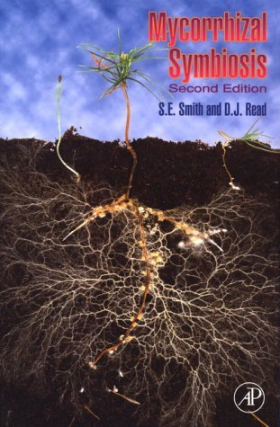
Introduction cont’d
Mycorrhizae is a symbiotic root fungus on pinyon pine trees
Fungus and tree benefit from this relationship
In pinyon-juniper woodlands ectomycorrhizae only found on pinyon trees
*Courtesy of Smith and Read, 1997

Slide 6
Hypotheses
Hybrid pinyon trees will exhibit mycorrhizae diversity that is consistent with previous research on 2-needle unstressed trees
Or:
Mycorrhizal diversity in root systems of hybrids will be similar to stressed 2-needle trees because the trees inhabit higher stress sites
Notes:
I think these still need some work to relate to my introduction. What do you think????

Slide 7
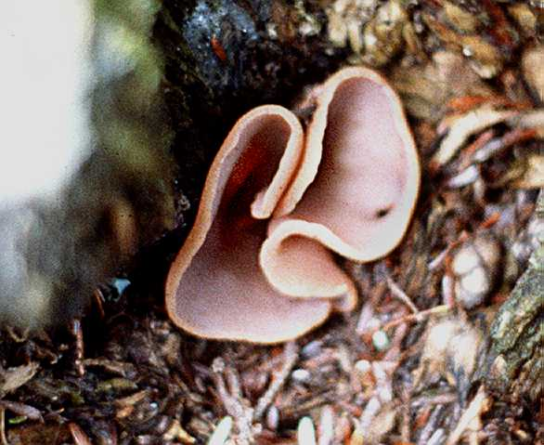
Methods
Root Samples taken on 40 hybrid trees in Stoneman Lake, Arizona
10 branch samples of each tree were also taken for development of hybrid ratio
Dissecting microscope used to identify and categorize root fungus
*Courtesy of Kris Haskins

Slide 8
Results
Limited mycorrhizae diversity observed throughout the 40 samples
Notes:
Kitty told me that Morph 2 was pezizales so I made it bright. I’m just going to explain here how our samples had a low diversity and only an abundance of morph 2 and 5 for the most part

Slide 9
Results cont’d
Ectomycorrhizae presence and level of hybridization had low correlation
Notes:
Flat relationship here throughout the hybridization gradient and % of EM present in the samples. However, there are slight trends in the data…I think we might see something more conclusive with your statistical program…..----I’d add the graph of type 2 ----when you explain this you will need to explain the “% one needle” metric since you have not gone over this yet

Slide 10
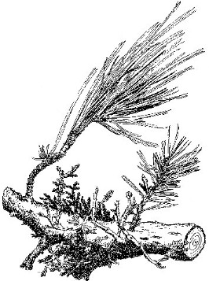
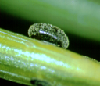
Discussion
Findings consistent with previous research on two-needle dominated trees
Stressed individuals indicated a high presence of a single fungal order, Pezizales
High Mistletoe
High Scale
High Juniper
*Courtesy of Catherine Gehring
Notes:
These are Kitty’s graphs showing how different levels of stress affect the diversity and abundance of mycorrhizal communities in two needle pines ------maybe show the contrast with low stress

Slide 11
Discussion cont’d
These graphs are similar to the findings in our hybrid gradient.
High presence of the Pezizales morphotype in samples

Slide 12
Conclusion
Research indicates that the hybrid trees are exhibiting similar stress characteristics that would be predicted based on the environment rather than based on their adaptation to drier sites
Further analysis of hybridization gradient needed to encompass a full range of 1 needle percentages.
Notes:
Conclusion I basically want to talk about how we can solidify our findings through further research in the specific ecosystem by Stoneman Lake….. -----I added a bit to the conclusion the futher research could be moved to another slide if you can not fit it on this one.

Slide 13
Conclusion cont’d
Further Research needed to identify environmental characteristics that could also lead to low fungal diversity,
Soil analysis could identify the productivity and suitability of the site
Competitive interactions were not analyzed, and study of stress factors is needed

Slide 14
Acknowledgments
NASA Space Grant Internship
NAU Biology Department
Amy Vaughn Whipple
Chris Sthultz
Catherine Gehring

